Slide 1

Capstone Project-4
Netflix Movies And TV Shows Clustering
Ashish Panjabrao Wasnik

Slide 2
DISCUSSION POINTS
Introduction
Problem statement
Data Exploration
Exploratory Data Analysis
Data Processing
Conclusion

Slide 3
Netflix
Netflix is an American subscription streaming service and production company. Launched on August 29, 1997, it offers a film and television series library through duration deals as well as its own productions, known as Netflix Originals. Netflix was founded on the aforementioned date by Reed Hastings and Marc Randolph in Scots Valley, California.
As of December 31, 2021, Netflix had over 221.8 million subscribers worldwide.
Netflix can be accessed via internet browsers on computers, or via application software installed on smart TVs, set-top boxes connected to television, tablet, computers, smartphone etc.

Slide 4
Problem Statement
This dataset consists of TV shows and movies available on Netflix as of 2019. The dataset is collected from Flexible which is a third-party Netflix search engine.
In 2018, they released an interesting report which shows that the number of TV shows on Netflix has nearly tripled since 2010. The streaming services number of movies has decreased by more than 2,000 titles since 2010, while its number of TV shows has nearly tripled. It will be interesting to explore what all other insights can be obtained from the same dataset.

Slide 5
Data Exploration
Show Id : Unique Id For Every Movie/ tv Shows
Type : Identifier- A Movie shows
Title: Title Of the Movie/ TV Shows
Director : Director Of The Movie
Cast : Actor involved in the Movie/Shows
Country: Country where the movie/ show Was Produced
Date_added : Date it was added on Netflix
release_year: Actual Release Year of the movies/shows
Duration : Total Duration- in minutes or number of seasons
Listed_in: Genre
Description: The Summery Description

Slide 6
DATA SUMMARY
The Dataset Contains 12 Columns And 7787 Rows.
There also exist some null values in our data.
Director Null Values: 30.68%
Cast Null Values : 9.22%
Country Null Values: 6.51%
date_added Null Values : 0.13%
rating Null Values : 0.09%
Since There are very few null values in date_added and rating we will drop them

Slide 7
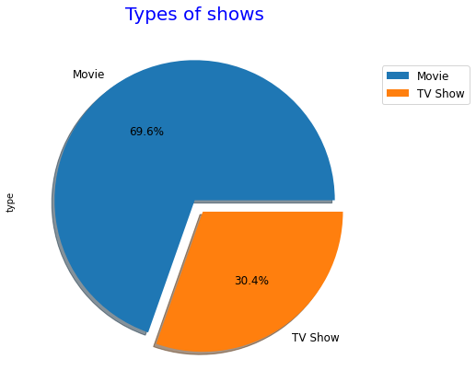
Exploratory Data Analysis
Type:
69.6% of the content available on the Netflix are Movies, Remaining 30.4% are TV shows

Slide 8
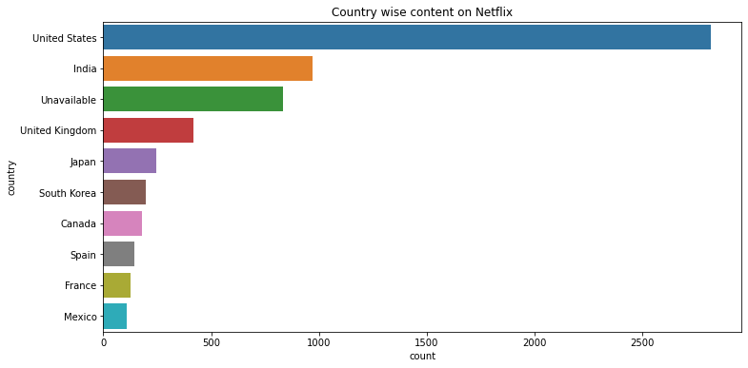
Continue……
Country
The majority of the content providers are in the top ten countries
USA, India and UK create more than half of the TV shows and movies on the platform

Slide 9
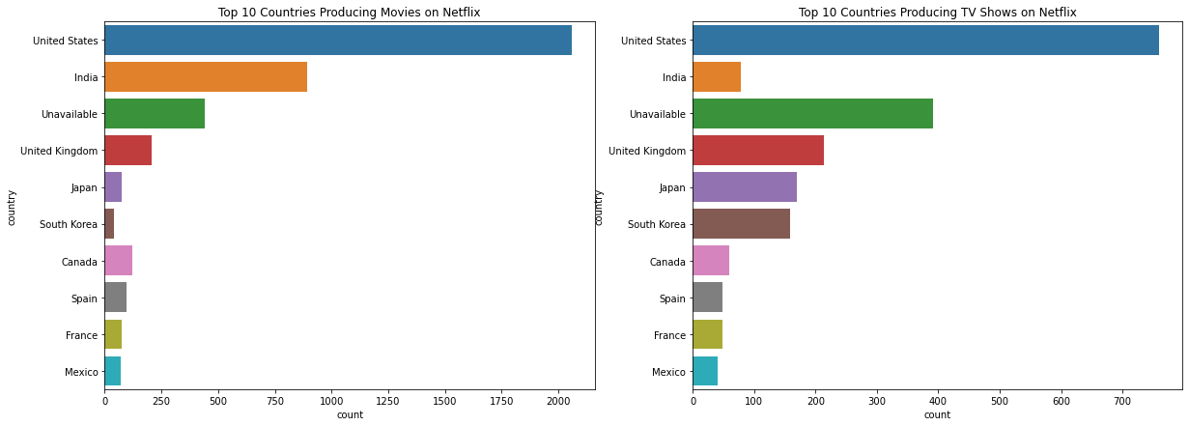
Continue….

Slide 10
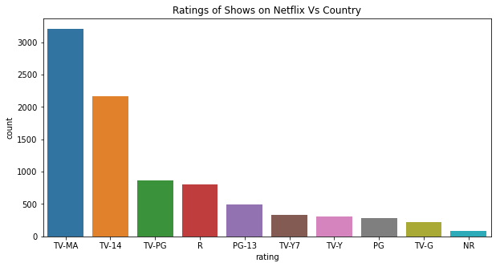
Continue……
Rating :-
TV-MA Tops The charts indicating the nature content is more popular on Netflix.
The Popularity is followed by TV-14 and TV-PG, which are shows focused on teens and older kids.

Slide 11
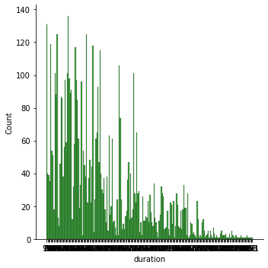
Continue…..
Duration :-
From given plot we can see that the majority of the movies range in length from 90 to 100 movies

Slide 12
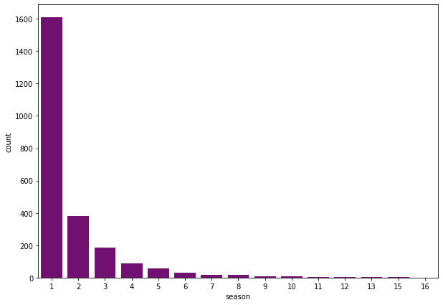
Continue……
Duration:
from given plot we can see that the majority of TV shows have only one season.

Slide 13
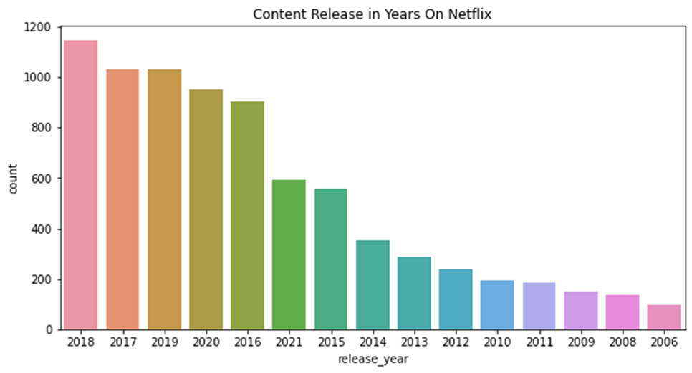
Release Year
Release year:
In Year 2018 has more content is release

Slide 14
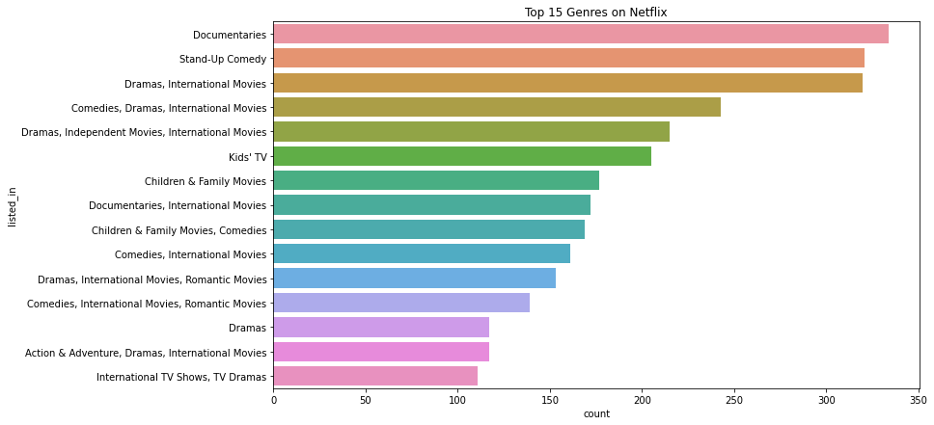
Popular Genres Analysis :
Documentaries, Comedies, Dramas, And International Movies popular choice in the countries.
It is Also observed that in the countries where the regional language is not English, international TV shows and movies are more demand

Slide 15
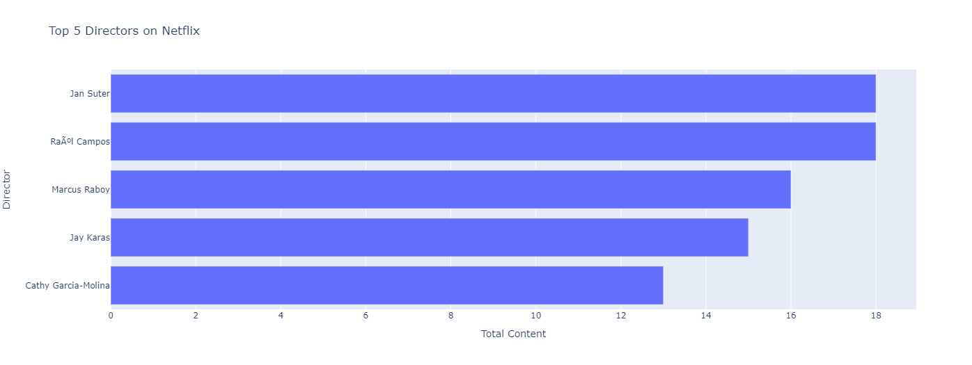
Director
Jan Suter, Rahul campos,marcus Raboy,jay karas, Cathy Garcia-Molina are the top 5 director which highest number of movies and TV shows.

Slide 16
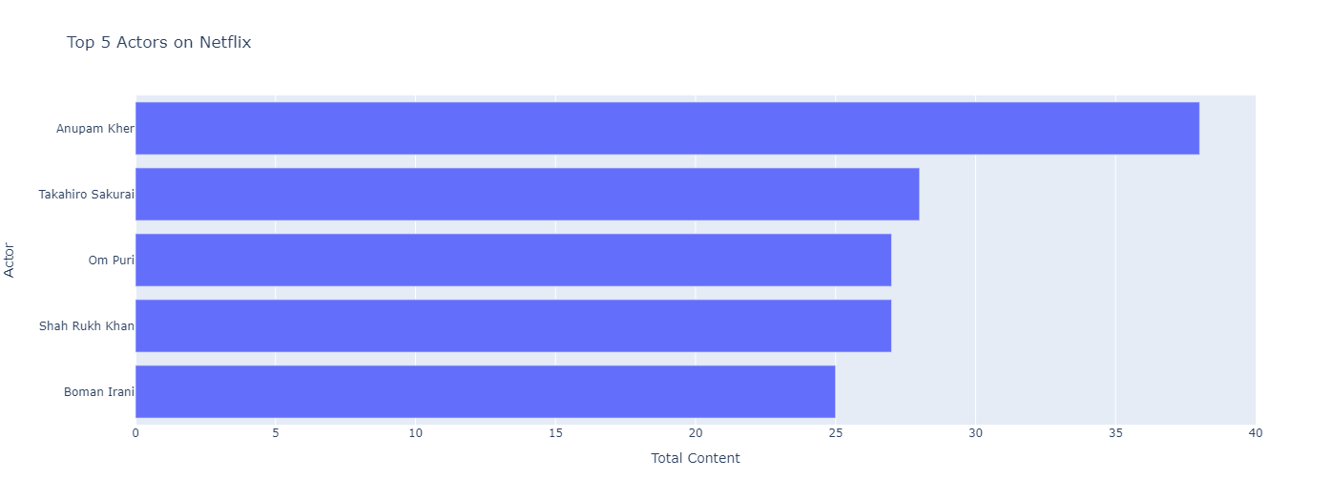
Cast:-
Top 5 actor with most number of TV shows and movies are from India
With Anupam kher are the top 38 TV shows and movies in total

Slide 17
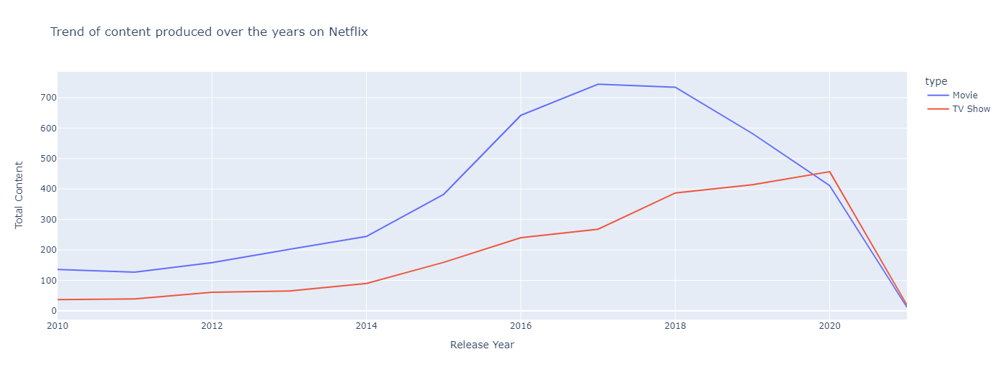
Year_added
Growth in the number of movies on Netflix is much higher than TV shows.
From 2014 we can see a noticeable addition in the number of movies and TV shows uploaded.
The highest number of movies and TV shows added in 2018 and 2020.
The line plot shows very few movies, and TV shows got added in 2021.it is due to very little data collected from the year 2021

Slide 18
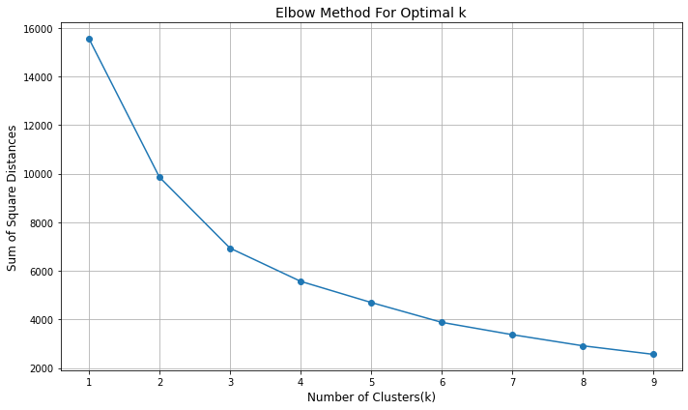
K Means- k means clustering is an unsupervised Learning algorithm which Group the unlabeled dataset the elbow is at k=3, indicating the optimal k for this dataset is 3. Let us visualize our data for different values of clusters , say 2,3,4,5,6,7,8 , for better understanding..

Slide 19
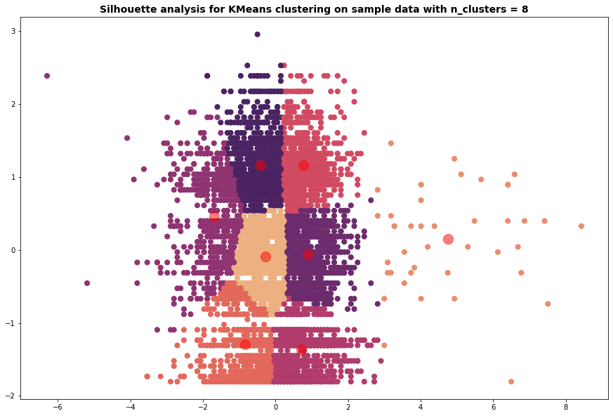
Evaluation:-
Silhouette scores :- is a metric to evaluate the performance of clustering algorithms. It uses compactness of individual clusters( intra cluster distance) and separation amongst clusters(inter cluster distance) to measure an overall representative score of how well our clustering algorithms has performed.
The silhouette score for K-means was in the range of 0.35 while in case of HAC we are getting close to 0.32.

Slide 20
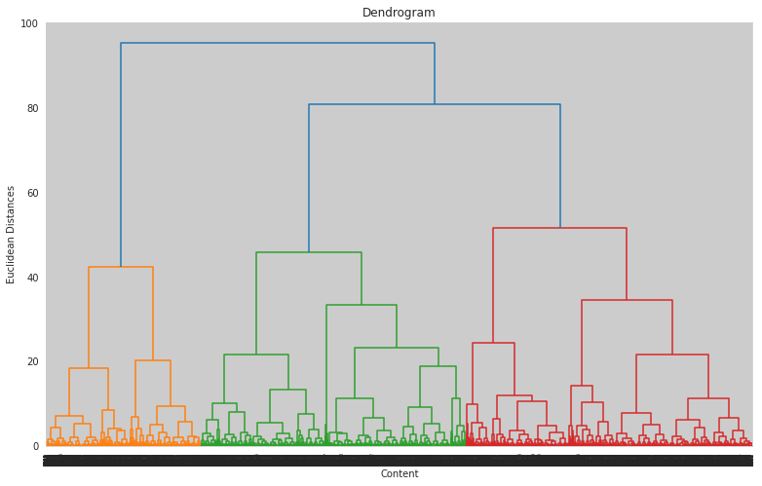
Hierarchical clustering:-
Hierarchical clustering is used to group the unlabeled datasets into a cluster and also known as hierarchical cluster analysis. In this algorithm, we develop the hierarchy of clusters in the form of a tree, and this tree-shaped structure is known as the dendrogram.The hierarchical clustering technique has two approaches:
Agglomerative: Agglomerative is a bottom-up approach, in which the algorithm starts with taking all data points as single clusters and merging them until one cluster is left.
Divisive: Divisive algorithm is the reverse of the agglomerative algorithm as it is a top-down approach.

Slide 21
Conclusion
We had performed lots of operations over the dataset to find out some very useful information from it. We have to conclude dataset in few lines, then we can say that.
Netflix has more Movies than TV shows.
Most of the number of Movies and TV shows produced by United States followed by India.
Most of the Content on Netflix (Movies and TV shows combined) is for mature Audience.
Majority of the movies range in length from 90 to 100 minutes and the majority of TV shows have only one season.
2018 is the year in which Netflix released allot more Content as compared to other years.
Dramas, International movies are the most popular Genres on Netflix.
The silhouette score for K-means was in the range of 0.35 while in case of HAC we are getting close to 0.32.

Slide 22
the top 5 directors on this platform are:
Jan sutar
Rahul compose
Marcus Raboy
Jay karas
Cathy Garcia-Molina
The Top 5 actors on this Platform:
Anupam Kher
Rupa Bhimani
Takahero Sakurai
Julie Tejwani
Om Puri
By sentimental analysis the overall positive content is always greater than the neutral and negative content combined.

Slide 23
Thank you

